Slide 1


The mutual influence of ligands in the internal sphere of coordination compounds
Al-Farabi Kazakh National University
Faculty of Chemistry and Chemical technology
Department of General and Inorganic Chemistry
PhD Bakhadur Askar

Slide 2



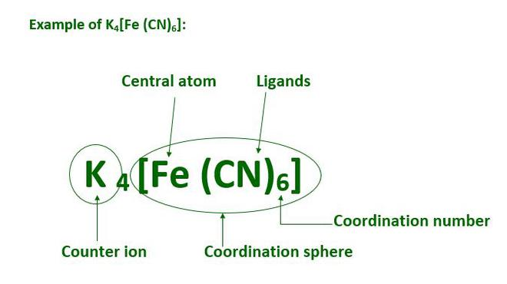
The internal coordination sphere
The internal (primary) coordination sphere consists of the metal ion and the ligands directly bonded to it through coordinate covalent bonds. The ligands in this inner sphere interact not only with the central atom but also with each other through electronic and spatial interactions.
These mutual influences determine:
The geometry of the complex,
The strength of each metal–ligand bond,
The reactivity, stability, and spectral properties of the compound.
Understanding these interactions provides insight into bonding mechanisms, reaction pathways, and design of coordination catalysts.

Slide 3
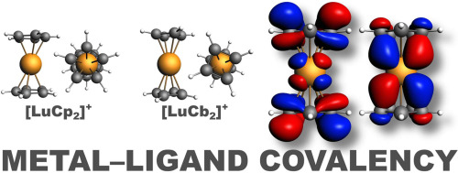
Nature of metal–ligand bonding
Metal–ligand bonding involves a mixture of ionic, covalent, and donor–acceptor interactions.
σ-Donation: The ligand donates a lone pair from its donor atom to an empty orbital of the metal ion.
π-Backbonding: The metal donates electron density back into an empty π* orbital of the ligand.
The balance between σ-donation and π-backbonding determines the electron distribution across the inner sphere.
Because ligands compete for the metal’s limited orbitals and electron density, the presence of one ligand can significantly alter the metal’s ability to interact with others — this is the essence of mutual ligand influence.

Slide 4
Electronic and inductive effects of ligands
Each ligand exerts an electronic effect on the metal center, which in turn modifies the bonding properties of the other ligands.
1. Inductive Effects:
Electron-withdrawing ligands (like CN⁻, NO₂⁻) pull electron density from the metal, making it more electrophilic and weakening other metal–ligand bonds. Electron-donating ligands (like NH₃, H₂O, PR₃) increase electron density on the metal, strengthening bonds to π-acceptor ligands.
2. Field Effects:
Ligands create an electric field that splits metal d-orbitals (ligand field theory). The arrangement of ligands influences this field, changing the energy and overlap of orbitals available for bonding.
Thus, each ligand not only binds but also modulates the bonding environment of all others through delocalized electronic effects.

Slide 5
The trans effect and trans influence
The trans effect and trans influence describe the way one ligand affects the bond strength and reactivity of another ligand positioned opposite (trans) to it in the coordination sphere.
Trans Effect: A kinetic phenomenon—certain ligands accelerate substitution of the ligand opposite to them. Strong trans-effect ligands: CO, CN⁻, phosphines, olefins.
Trans Influence: A thermodynamic effect—certain ligands weaken the bond strength of the ligand trans to them in the ground state.
These effects arise from π-backbonding and σ-competition, where electron-dense ligands compete for the same d-orbitals of the metal, altering bond strengths and substitution patterns.
This principle is essential in the synthesis of square-planar and octahedral complexes, including many organometallic catalysts.

Slide 6
Synergic and antagonistic ligand interactions
Ligands can exhibit synergic or antagonistic interactions depending on how their bonding modes complement or oppose each other.
Synergic Interactions: Occur when ligands cooperate electronically — for example, a π-acceptor ligand (CO) benefits from a neighboring σ-donor ligand (PPh₃), leading to greater metal–ligand delocalization and bond stabilization.
Antagonistic Interactions: Happen when ligands compete for electron density or orbital overlap, leading to weakened metal–ligand bonds or altered geometry.
Such interactions can drastically influence reaction mechanisms, spin states, and spectroscopic properties of complexes.

Slide 7
Spectrochemical and ligand field consequences
The mutual influence of ligands is reflected in the spectrochemical properties of coordination compounds.
Ligands of different field strengths change the crystal field splitting energy (Δ), leading to shifts in the absorption spectrum (color changes).
Strong-field ligands enhance Δ, often converting high-spin complexes to low-spin ones.
Ligand combinations can produce mixed-field environments, explaining intermediate colors and magnetic moments.
Through Ligand Field Theory (LFT) and Molecular Orbital Theory (MOT), chemists can quantitatively analyze how one ligand modifies the electronic potential experienced by others.

Slide 8
Impact on stability and reactivity
Mutual ligand influence affects both thermodynamic stability and chemical reactivity of complexes.
Stability: Complexes with cooperative ligand interactions (such as chelation or π-synergy) are more stable due to electron delocalization.
Reactivity: Electron-withdrawing ligands often activate the metal center for oxidative addition, while electron-donating ligands promote reductive elimination. Thus, by varying ligands, chemists can tune reaction pathways — a fundamental concept in catalysis and organometallic chemistry.
In biological systems, this mutual influence is key to enzyme active site tuning, allowing selective binding and transformation of substrates.

Slide 9
Summary
The internal coordination sphere is a complex electronic environment where ligands influence each other through σ and π interactions, inductive effects, and field modulation.
Mutual ligand influence governs bond strength, geometry, color, magnetic behavior, and reactivity.
Trans effects, synergic cooperation, and antagonistic competition define substitution rates and equilibrium structures.
Ligand field variations explain diverse spectroscopic and magnetic phenomena in transition metal chemistry.
These interactions are the foundation of rational ligand design, enabling control over catalytic activity, biochemical selectivity, and materials functionality.
The mutual influence of ligands within the internal coordination sphere illustrates the highly interconnected nature of coordination chemistry. By understanding and manipulating these interactions, chemists can design metal complexes with tailored electronic, geometric, and reactive properties — bridging fundamental theory and applied science.

Slide 10
Thank you for attention!

